Slide 1

LINEAR EQUATIONS
24th SEPT 2026

Slide 2
Introduction
An equation is a mathematical statement that indicates the equality of two expressions. The equal signs equate the two expressions.
A linear equation is one where the dependent variable (Y) and the independent variable have a linear relationship ie; a change in X results in a proportionate change in Y (if X changes, then Y must change by the same proportion).
These equations produce a straight line when graphed.

Slide 3
Simultaneous linear equation systems
A simultaneous linear equation is a system/group/set of two or more equations with the same unknowns.
To solve such a system, one needs to compute the values of each of the unknowns using different methods such as; elimination, substitution, row operation, and graphical methods as detailed in subsections below.
Consider the equations below, they form a system of simultaneous linear equations.
NOTE: To solve a given system of simultaneous equations, the number of equations SHOULD always be equal to the number of unknows.
A. X+ 2Y=45 3X+4Y=20 | B. X+ 2Y+6Z=30 3X+4Y+Z=15 4X+Y+2Z=5

Slide 4
Graphical solutions
One of the methods of solving simultaneous equations is the graphical method.
This entails plotting the equations on the same graph and finding their point of intersection which is a SOLUTION to the equations being solved.
A system of simultaneous equations can have the following three types of solutions;
One unique solution
Infinite Many Solutions
No solution

Slide 5
Graphical solutions (Ct’d)
Types of graphical solutions;
One unique solution: In this case, the linear equations intersect at a particular point which forms the solution of the equations being solved. There is a unique solution in the sense that there is a pair of values (one for each of the variables).
Infinite Many Solutions: This is a type of solution where the equations appear to be on the same straight line when plotted on the same graph. In this case, it can be said that the equations are similar. In this case, there are infinitely many solutions for that system of equations. All pairs of values on that particular line satisfy the given system of equations being solved.
No solution: In this case the lines are parallel to one another when plotted on the same graph. This implies that there are no pairs of variables (X,Y) which lie on both line.

Slide 6
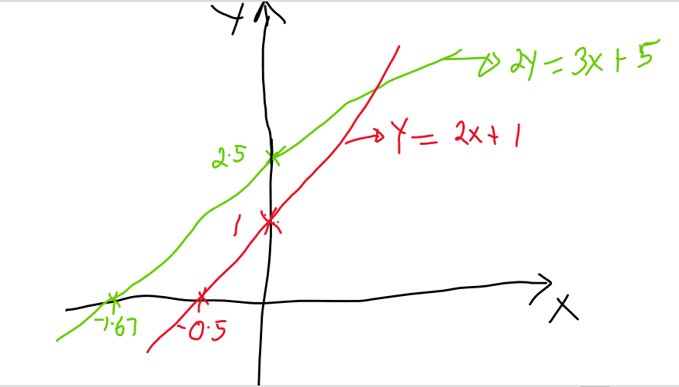
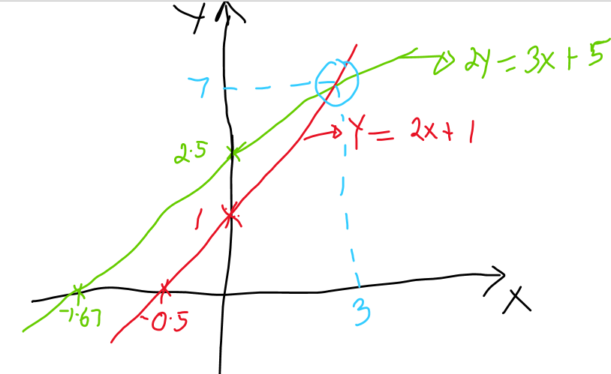
Graphical solutions (Example)
Solve the following simultaneous equations using the graphical method.
y−2x=1
2y−3x=5
Solution
Step One: Plot each of the equations on the graph.
Step Two: Mark out the point of Intersection
Y= 2X+1 |  |  |  | 2Y=3X+5
X | Y | Coordinates |  | X | Y | Coordinates
0 | 1 | (0,1)
0 | 1 | (0,1) |  | 0 | 2.5 | (0,2.5)
-0.5 | 0 | (-0.5,0) |  | -1.66667 | 0 | (-1.66667,0)
Step Three: Read the pair of values for X, Y at the Point of Intersection (that’s the solution to the equations being solved): Therefore, the solution is (3,7)

Slide 7
Exercise
Solve the following simultaneous equations using the graphical method.
A. 2X +4Y=3 -6X-12Y= -9 C. Y=3X-11 Y=-2X+4 | B. 3X +4Y=9 -6X-8Y=10

Slide 8
Equating to the same variable
To equate to the same variable; implies that you make one of the variables in a given system of simultaneous equation’s the subject of the formula- say Y in each of the given equations.
For example; Given the equations below;
y−2x=1
2y−3x=5

Slide 9
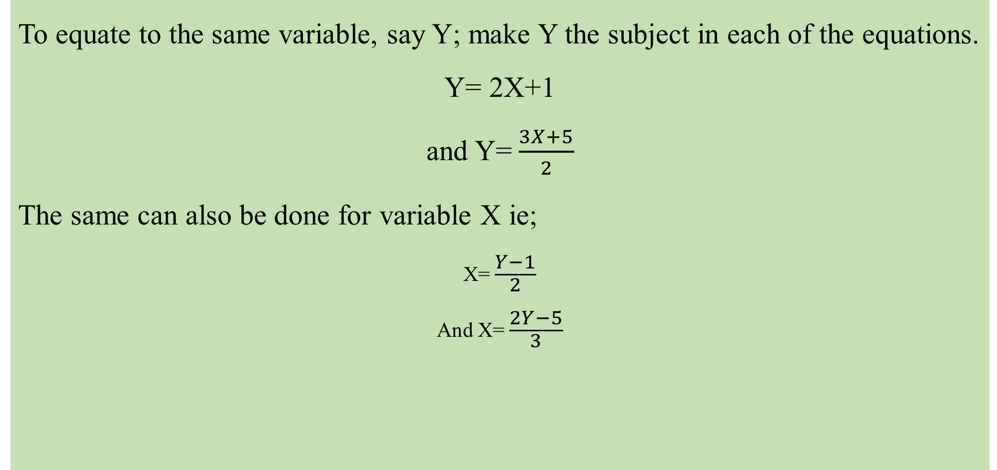
Solution
To equate to the same variable, say Y; make Y the subject in each of the equations.
Y= 2X+1
and Y=$\frac{3X+5}{2}$
The same can also be done for variable X ie;
X=$\frac{Y−1}{2}$
And X=$\frac{2Y−5}{3}$

Slide 10
Substitution method
This is the method of solving simultaneous equations in which one equation is substituted in the other in order to eliminate one of the variables.
This helps to solve for one of the variables and then later the value of this variable is substituted in one of the equations to compute the value of the remaining variable.
For example: Solve the equations.
Y−2X=1
2Y−3X=5

Slide 11
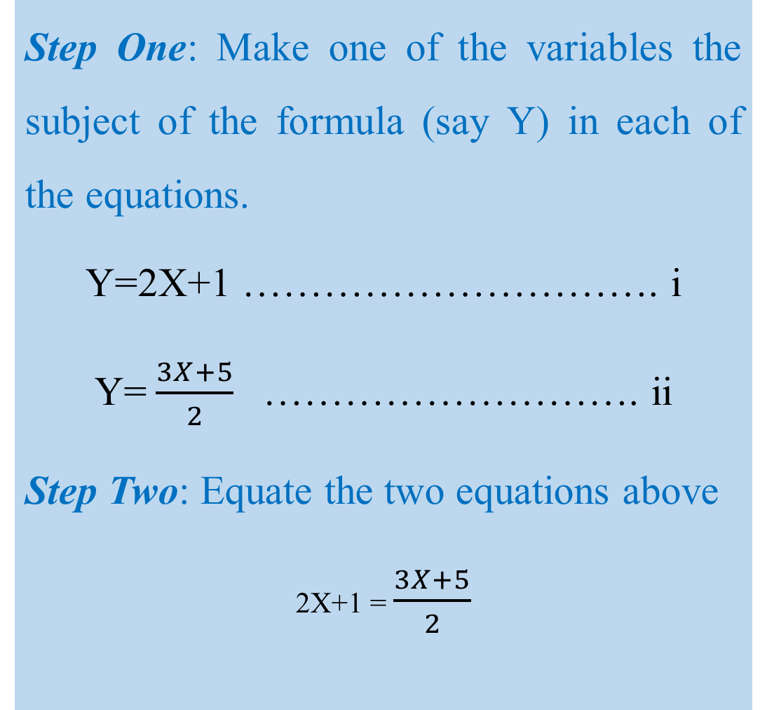
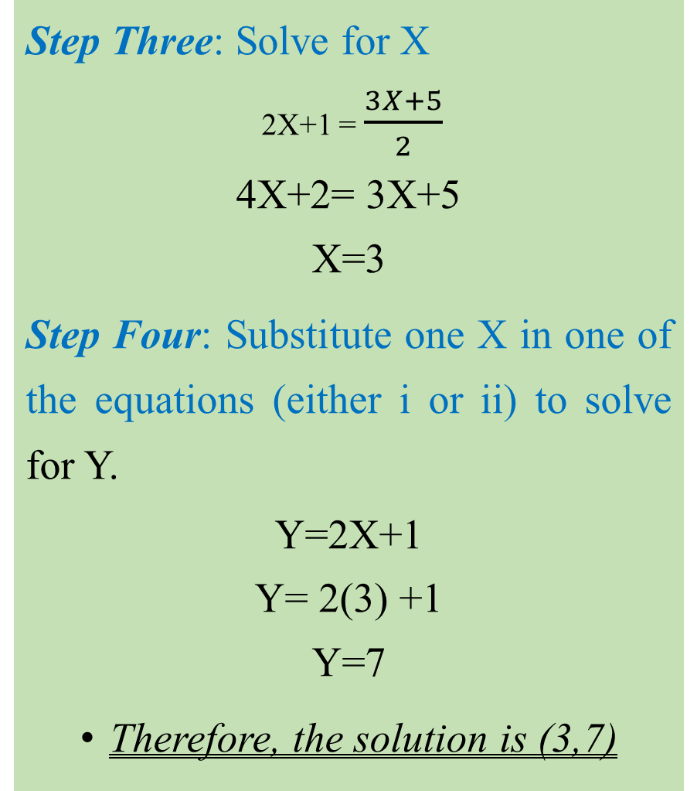
Solution
Step One: Make one of the variables the subject of the formula (say Y) in each of the equations.
Y=2X+1 …………………………. i
Y=$\frac{3X+5}{2}$ ………………………. ii
Step Two: Equate the two equations above
2X+1 = $\frac{3X+5}{2}$
Step Three: Solve for X
2X+1 = $\frac{3X+5}{2}$
4X+2= 3X+5
X=3
Step Four: Substitute one X in one of the equations (either i or ii) to solve for Y.
Y=2X+1
Y= 2(3) +1
Y=7
Therefore, the solution is (3,7)

Slide 12
Exercise
Solve the following simultaneous equations using the substitution method.
A. 2X +4Y=3 -6X-12Y= -9 C. Y=3X-11 Y=-2X+4 | B. 3X +4Y=9 -6X-8Y=10

Slide 13
Solving Equations With More than two unknowns
One of the methods of solving simultaneous equations with more than two unknowns is called the elimination method (one of the variables is eliminated to solve for others).
NOTE: This method can also be used in systems of equations with only two variables.
How to use the elimination method
Given the simultaneous equations below;
2X-Y+3Z= 10 …………………………. i
X+3Y-2Z=5 …………………………. ii
3X-2Y+4Z=12 …………………………. iii

Slide 14
Elimination method (Solution)
Step One: Eliminate one of the variables to form linear equations (USE TWO PAIRS OF THE GIVEN EQUATIONS).
How? To eliminate Y in equations i and ii for example, we multiply equation i by 3 and solve for the two linear equations ie
3(2X-Y+3Z= 10) …………………………. (a)
X+3Y-2Z=5 …………………………. ii
6X-3Y+9Z= 30 …………………………. (a)
X+3Y-2Z=5 …………………………. ii

Slide 15
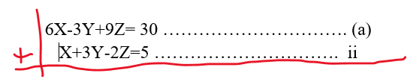
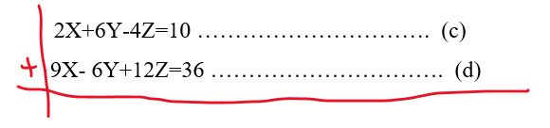
Step Two:
Then add equation a to equation ii
7X+0+7Z=35
7X+7Z=35 …………………………. (b)
To get another linear equation, eliminate Y in equations ii and iii as below
X+3Y-2Z=5 …………………………. ii
3X-2Y+4Z=12 …………………………. iii
So, multiply equation ii by 2 and equation iii by 3 and add the two equations.
2(X+3Y-2Z=5) …………………. (c)
3(3X-2Y+4Z=12 ………………. (d)
2X+6Y-4Z=10 …………………. (c)
9X-6Y+12Z=36 ………………. (d)
11X+0+8Z=46 …………………………. (e)
11X+8Z=46 ……………………………. (e)

Slide 16
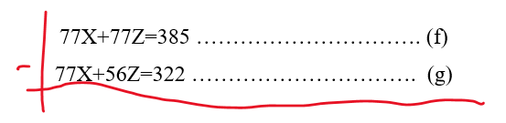
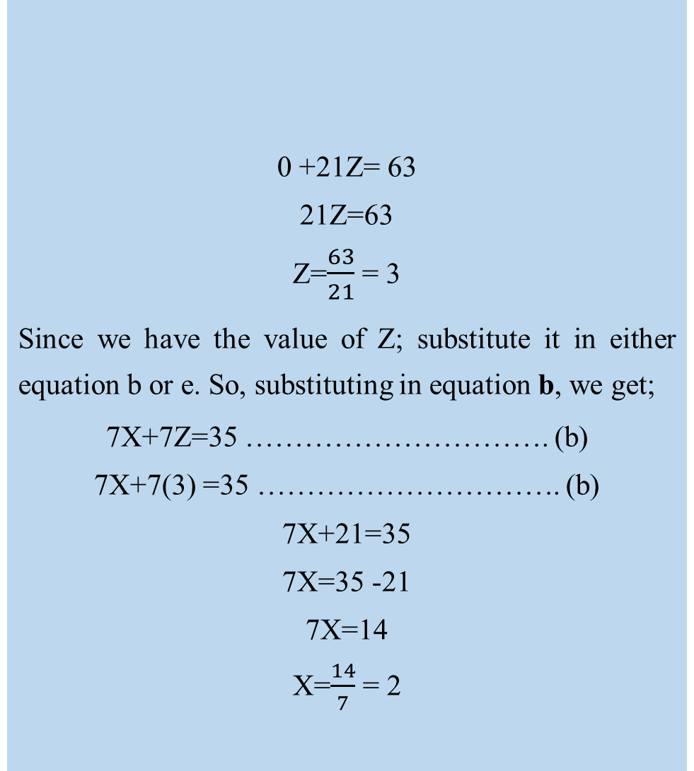
Step Three:
Since we have two linear equations (ie b and e), we can now solve them using any method; say elimination method.
7X+7Z=35 …………………………. (b)
Multiply equation b by 11 and equation e by 7 and then subtract the two equations.
11(7X+7Z=35) …………………………. (f)
7(11X+8Z=46) …………………………. (g)
77X+77Z=385 …………………………. (f)
77X+56Z=322 …………………………. (g)
0 +21Z= 63
21Z=63
Z=$\frac{63}{21}$ = 3
Since we have the value of Z; substitute it in either equation b or e. So, substituting in equation b, we get;
7X+7Z=35 …………………………. (b)
7X+7(3) =35 …………………………. (b)
7X+21=35
7X=35 -21
7X=14
X=$\frac{14}{7}$ = 2

Slide 17
Step Four:
Substitute the values of X and Z in either equation i, or ii or iii. So, substituting in equation i;
2X-Y+3Z= 10 …………………………. i
2(2)-Y+3(3) = 10
4-Y+9=10
-Y+13=10
-Y=-3
Y=3
Therefore, the solution is (2,3,3)

Slide 18
Exercise
Solve the following simultaneous equations using the elimination method.
X+ 2Y+6Z=30 3X+4Y+Z=15 4X+Y+2Z=5 | B. 3X+2Y=7 5X+Y=7

Slide 19
Agricultural Applications and solving related problems
Linear equations can be used for several purposes in agriculture and the most notable ones include;
Estimation of demand and supply. For example; given the following demand and supply functions, the equilibrium price and quantity can be computed.
Qs= 5p-25
Qd= -2P+24
2. Input-Output Analysis; Farmers use these equations to estimate different units of input that are related to different levels of output. By doing this, the right combination of input that produces the largest level of input is selected.
For example, given the following input-output equations, what combination of fertilizer and land acreage should the farmer choose to maximize his maize production?
26.53 = 0.82 Units of Fertilizer−0.03 Land Acreage …………………………….. (i)
36.06 = −0.21 Units of Fertilizer + 0.96 Land Acreage……………………….. (i)
So, by solving for Xs (Units of Fertilizer and Land Acreage), the right combination of inputs (Xs) can be selected by the farmer.

Slide 20

Thank you
@ASK

